Slide 1



Vivekananda College of Engineering & Technology
[A Unit of Vivekananda Vidyavardhaka Sangha Puttur®] Affiliated to Visvesvaraya Technological University
Approved by AICTE New Delhi & Recognised by Govt of Karnataka
A Mini Project Presentation on
“IRIS SEGMENTATION”
Presented by
HITHA (4VP20AI011)
KARTHIK (4VP20AI013)
DEPARTMENT OF ARTIFICIAL INTELLIGENCE & MACHINE LEARNING 2022-23

Slide 2
CONTENTS:
Introduction
Problem Identification
Literature Survey
Objectives
Methodology
Flow Diagram
Result
Conclusion
References

Slide 3
INTRODUCTION:
The iris is a thin circular diaphragm, which lies between the cornea and the lens of the human eye.
The iris is perforated close to its centre by a circular aperture known as the pupil.
The function of the iris is to control the amount of light entering through the pupil, and this is done by the sphincter and the dilator muscles, which adjust the size of the pupil. The average diameter of the iris is 12 mm, and the pupil size can vary from 10 to 80 percents of the iris diameter .
Among various biometric technologies, such as finger-prints and face, iris recognition has a relatively short history of use. There are few large-scale experimental evaluations reported in the literature, and essentially none where the image dataset is available to other researchers.
One constraint of current iris recognition systems, which is perhaps not widely appreciated, is that they require substantial user cooperation in order to acquire an image of sufficient quality for use.
A number of groups have explored iris recognition algorithms and some systems have already been implemented and put into commercial practice by companies such as Iridian Technologies, Inc., whose system is based on the use of Daugman’s algorithm.

Slide 4
Problem Identification:
The problem identification in iris segmentation refers to the specific challenges and issues faced when attempting to accurately and effectively segment the iris region from an eye image.
Iris segmentation is an essential step in many applications, such as biometric identification systems, where the unique patterns of the iris are used for identification or authentication.
Some of the key problems in iris segmentation include:
1. Eyelash and eyelid occlusions: Eyelashes and eyelids can partially or completely cover the iris region, making it challenging to accurately detect and segment the iris boundaries.
2. Iris deformation: The shape of the iris can change due to factors such as pupil dilation, different lighting conditions, and eye movements. These variations make it difficult to establish consistent and reliable iris boundaries.
Addressing these problems typically involves the development and application of advanced image processing and computer vision techniques, such as edge detection, morphological operations, and machine learning algorithms. Researchers continue to work on improving iris segmentation methods to overcome these challenges and achieve more reliable and robust results.

Slide 5
Literature Survey
1] R. H. Farouk, H. Mohsen and Y. M. Abd El-Latif, "Iris Recognition System Techniques: A Literature Survey and Comparative Study," 2022 5th International Conference on Computing and Informatics (ICCI), New Cairo, Cairo, Egypt, 2022.
The main objective of this comparative study is to present a comprehensive review of literature on one of the biometric identification systems namely the iris recognition system. Biometric authentication has been introduced as one of the most fundamental security technologies. As most human phenotypes are unique, physiological features such as fingerprints, iris color, facial patterns, and geometry are used as security passwords. Because of its dependability, iris receives the greatest attention in the authentication.[1] The segmentation, border defining, feature extraction, and matching methods are analyzed in this work. Most of the used iris datasets are also presented in the paper. The purpose of this research is to investigate current iris recognition systems and describe their phases.

Slide 6
2] Deep Learning for Iris Recognition: A Review Yimin Yin, Siliang He, Renye Zhang, Hongli Chang, Xu Han, Jinghua Zhang
Iris recognition is a secure biometric technology known for its stability and privacy.[2] With no two irises being identical and little change throughout a person's lifetime, iris recognition is considered more reliable and less susceptible to external factors than other biometric recognition methods. Unlike traditional machine learning-based iris recognition methods, deep learning technology does not rely on feature engineering and boasts excellent performance. This paper collects 120 relevant papers to summarize the development of iris recognition based on deep learning. We first introduce the background of iris recognition and the motivation and contribution of this survey. Then, we present the common datasets widely used in iris recognition. After that, we summarize the key tasks involved in the process of iris recognition based on deep learning technology, including identification, segmentation, presentation attack detection, and localization. Finally, we discuss the challenges and potential development of iris recognition. This review provides a comprehensive sight of the research of iris recognition based on deep learning

Slide 7
Objectives
The objectives of iris segmentation using digital image processing are as follows:
Localization: The first objective is to accurately locate the region of the iris within an eye image.
1. Iris segmentation aims to identify the boundaries of the iris by distinguishing it from the surrounding regions such as the sclera (white part of the eye) and the eyelids.
2. Extraction: Once the iris region is localized, the objective is to extract only the iris portion from the rest of the image. This involves separating the iris pixels from the surrounding non-iris pixels, effectively isolating the iris for further analysis.
3. Feature Extraction: After segmentation and extraction, the iris region can be analyzed for various features that are unique to each individual, such as the texture patterns, crypts, and furrows present on the iris. These features can be used for biometric identification or authentication purposes, as the iris is highly distinctive and stable over time.

Slide 8
4. Recognition: The ultimate objective of iris segmentation is to enable accurate iris recognition. By segmenting the iris and extracting its distinctive features, it becomes possible to compare them with a pre-existing database of iris templates for identification or verification. Iris recognition systems often employ various matching algorithms to determine the similarity between iris features and make accurate identity decisions.
5. Improving Performance: Another objective of iris segmentation is to enhance the performance of iris recognition systems. By accurately segmenting the iris, the quality of the extracted iris features can be improved, leading to more reliable and accurate recognition results. This involves addressing challenges such as occlusions, reflections, and variations in iris size and shape.
Overall, the objectives of iris segmentation in digital image processing revolve around accurately localizing, extracting, and analyzing the iris region to enable reliable iris recognition, which can be applied in various fields such as biometrics, security systems, and access control.

Slide 9
Methodology
The system is to be composed of a number of sub-systems, which correspond to each stage of iris recognition. These stages are:
Preprocessing
Pupil Localization
Iris Localization
Iris Normalization
Iris Segmentation
Feature Extraction

Slide 10
1. Preprocessing:
The first step is to preprocess the eye image to enhance its quality and remove any noise or artifacts.
This typically involves operations like image resizing, noise reduction, and contrast enhancement.
2. Pupil Localization:
The next step is to locate the pupil, which is the dark circular region at the center of the iris.
This can be achieved using techniques like thresholding, edge detection, or Hough circle transform.
These methods help identify the circular boundary of the pupil.

Slide 11
3. Iris Localization:
Once the pupil is located, the next step is to extract the iris region surrounding the pupil.
This is done by defining an annular region of interest (ROI) around the pupil.
The inner boundary of the ROI is determined by the pupil boundary, and the outer boundary is estimated based on the expected iris size.
4. Iris Normalization:
In this step, the iris region is normalized to a standard size and shape.
This is important for achieving robust matching across different iris images.
Normalization techniques typically involve unwrapping the iris region from the annular shape to a rectangular shape and resizing it to a fixed dimension.

Slide 12
5. Iris Segmentation:
After normalization further segmentation may be performed to refine the iris region and remove any remaining noise or occlusions.
Various algorithms can be used, such as texture analysis, edge detection, or clustering techniques, to identify and eliminate unwanted regions within the iris..
6. Feature Extraction:
Finally, feature extraction is performed to capture the unique patterns present in the segmented iris region.
This typically involves techniques like Gabor filtering, wavelet analysis, or local binary patterns to extract the iris texture features.

Slide 13
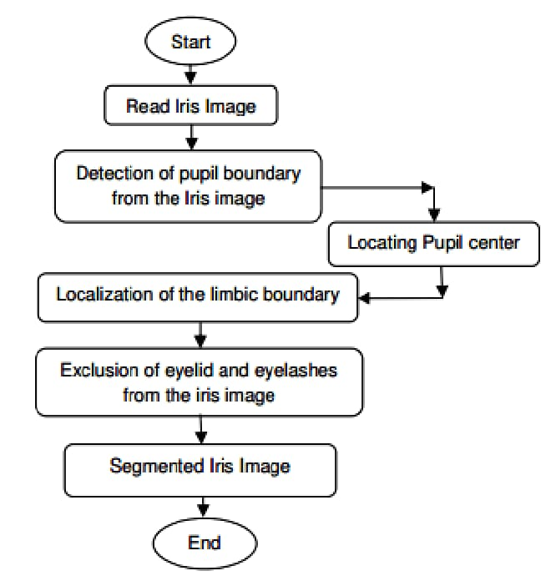
Flow Diagram

Slide 14
Result
The result of iris segmentation using digital image processing techniques is the extraction of the iris region from an eye image
The final result of iris segmentation is a binary mask or a segmented image where the iris region is separated from the rest of the eye image. This segmented iris region can then be further processed for feature extraction and matching in iris recognition systems.

Slide 15
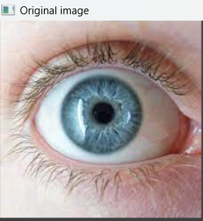
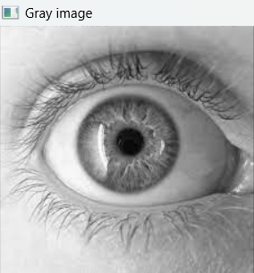
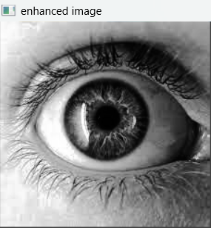
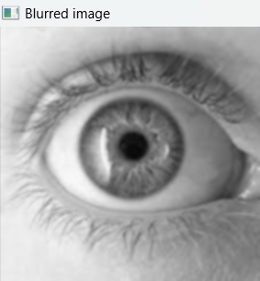
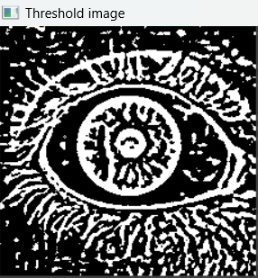
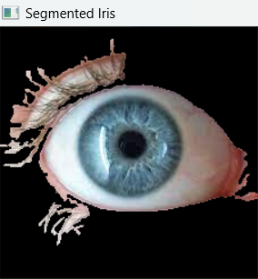

Slide 16
Conclusion
Iris segmentation using digital image processing depends on the specific methods and techniques employed in the process. However, in general, iris segmentation is a crucial step in iris recognition systems and has several important applications in biometric authentication, security systems, and medical diagnostics.
Iris segmentation using digital image processing techniques plays a vital role in iris recognition systems. It enables the extraction of iris features and contributes to accurate and reliable biometric authentication. Ongoing research and advancements in image processing algorithms continue to enhance the accuracy and efficiency of iris segmentation, making it a promising field with vast potential for various applications in the future.

Slide 17
References
R. H. Farouk, H. Mohsen and Y. M. Abd El-Latif, "Iris Recognition System Techniques: A Literature Survey and Comparative Study," 2022 5th International Conference on Computing and Informatics (ICCI), New Cairo, Cairo, Egypt, 2022
Deep Learning for Iris Recognition: A Review Yimin Yin, Siliang He, Renye Zhang, Hongli Chang, Xu Han, Jinghua Zhang.
AN ENHANCED ENSEMBLE HYBRID DEEP LEARNING ALGORITHM FOR IMPROVING THE ACCURACY IN IRIS SEGMENTATION by M. Sathiya,K. Karunambiga, G. Sai Chaitanya Kumar and S. Chandra Sekaran.
Digital Image Processing,3rd edition Book by Rafael C. Gonzalez and Richard E. Woods
Digital Image Processing, 1st edition Book by S Sridhar

Slide 18
Thank you

